Slide 1
An Application for secure e-mail exchange: encryption-decryption with LEA cipher in CBC mode, including secure delivery of the secret key with EC EL-GAMAL + Rabin signature Students: Sapir Dayan, Amit Ben-David, Dana Asulin, Maryanne Halabi

Slide 2
LEA - Lightweight Encryption Algorithm
LEA is a symmetric key block cipher.
LEA has three different key lengths: 128, 192, and 256 bits.
We focus on LEA with 128 bits block cipher.
LEA-128 has 24 rounds that will define the schedule keys.

Slide 3
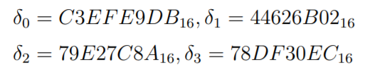
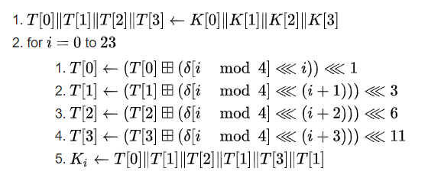
Key schedule for LEA-128

Slide 4
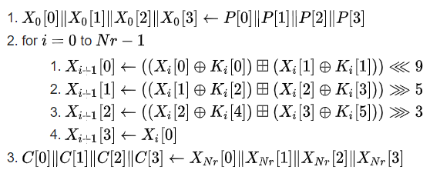

LEA -Encryption
Nr=24 (number of rounds).
P is the plaintext.
*each of P[i] is 32 bits.
Each of Ki is schedule key that calculated before.
The last iteration gives the cipher text and put in C array.

Slide 5
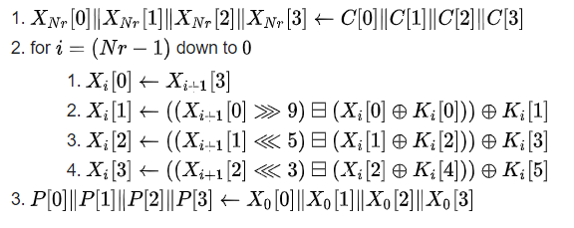
LEA – Decryption

Slide 6
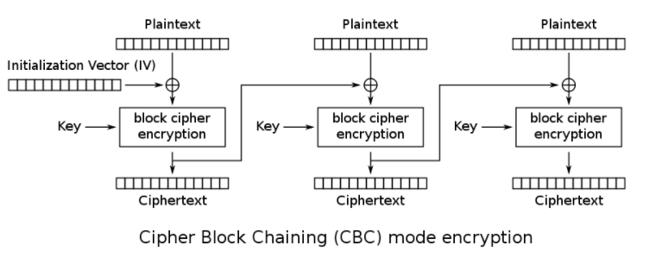
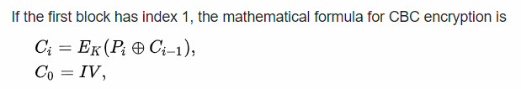
Encryption with CBC Mode

Slide 7
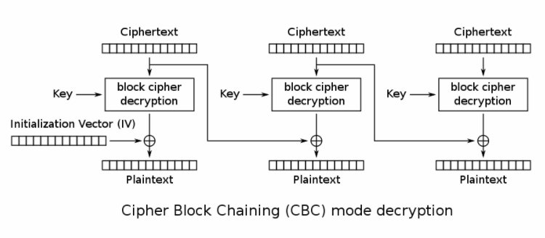
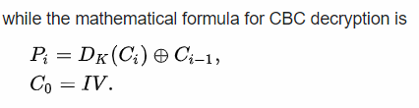
Decryption with CBC Mode

Slide 8
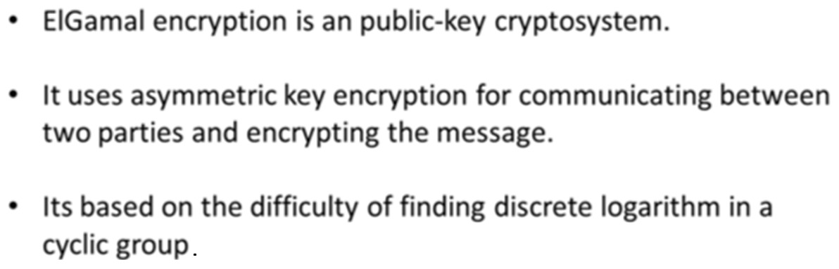
El GAMAL ENCRYPTION

Slide 9
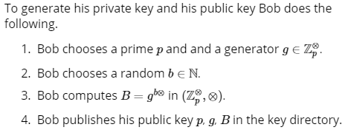
El GAMAL ENCRYPTION
First stage – bob generates a key :

Slide 10
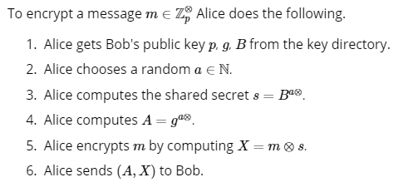
El GAMAL ENCRYPTION
Second stage – Alice message encryption :

Slide 11
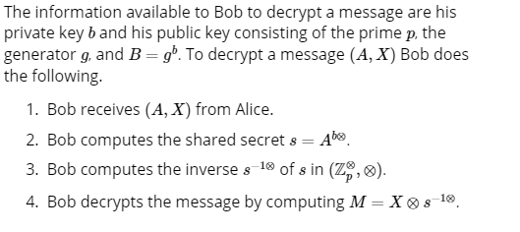
El GAMAL ENCRYPTION
Third stage – Bob message encryption :

Slide 12
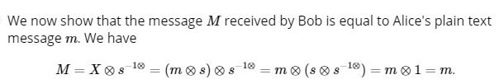
El GAMAL ENCRYPTION
Finally – The message is passed successfully :
https://youtu.be/LcQEkGciuB0

Slide 13
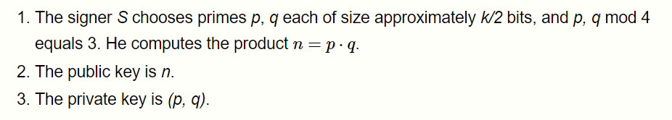
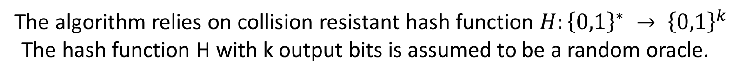
RABIN SIGNATURE
The algorithm relies on collision resistant hash function $H:{\left\{0,1\right\}}^{∗} → {\left\{0,1\right\}}^{k}$
The hash function H with k output bits is assumed to be a random oracle.
First Stage – key generation-

Slide 14
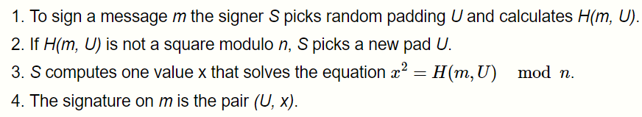
RABIN SIGNATURE
second Stage – Signing the message -

Slide 15
RABIN SIGNATURE
Last Stage – Verification -

